Slide 1
Direct Fabrication of Low-Temperature Co-fired Ceramics (LTCC) Circuits
Wenbin Li,
Austin Martin,
6/12/2018

Slide 2
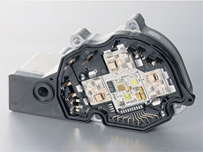
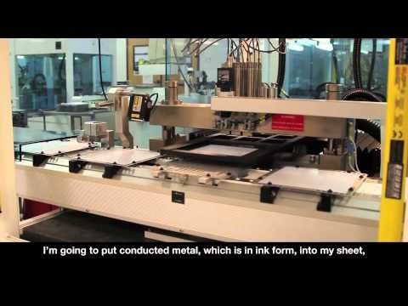
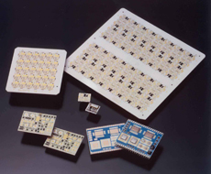
LTCC and HTCC, and their applications
LTCCs in vehicle EPS *
(electric power steering)
LTCCs in high frequency wireless modules
https://www.youtube.com/watch?v=oYLQc-uVClE&t=50s

Slide 3
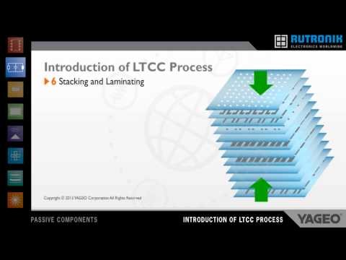
Conventional LTCC/HTCC fabrication process
https://www.youtube.com/watch?v=N85Tx_7HPZs&t=17s

Slide 4
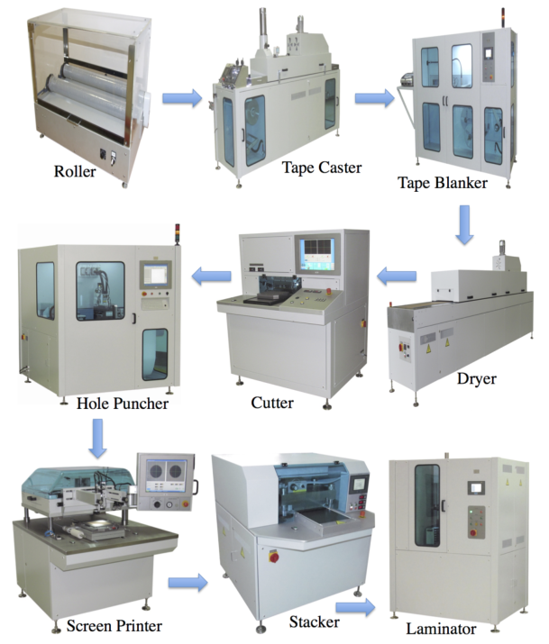
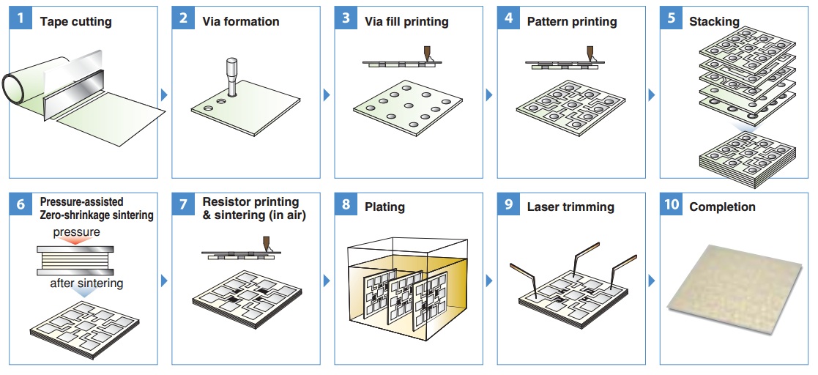
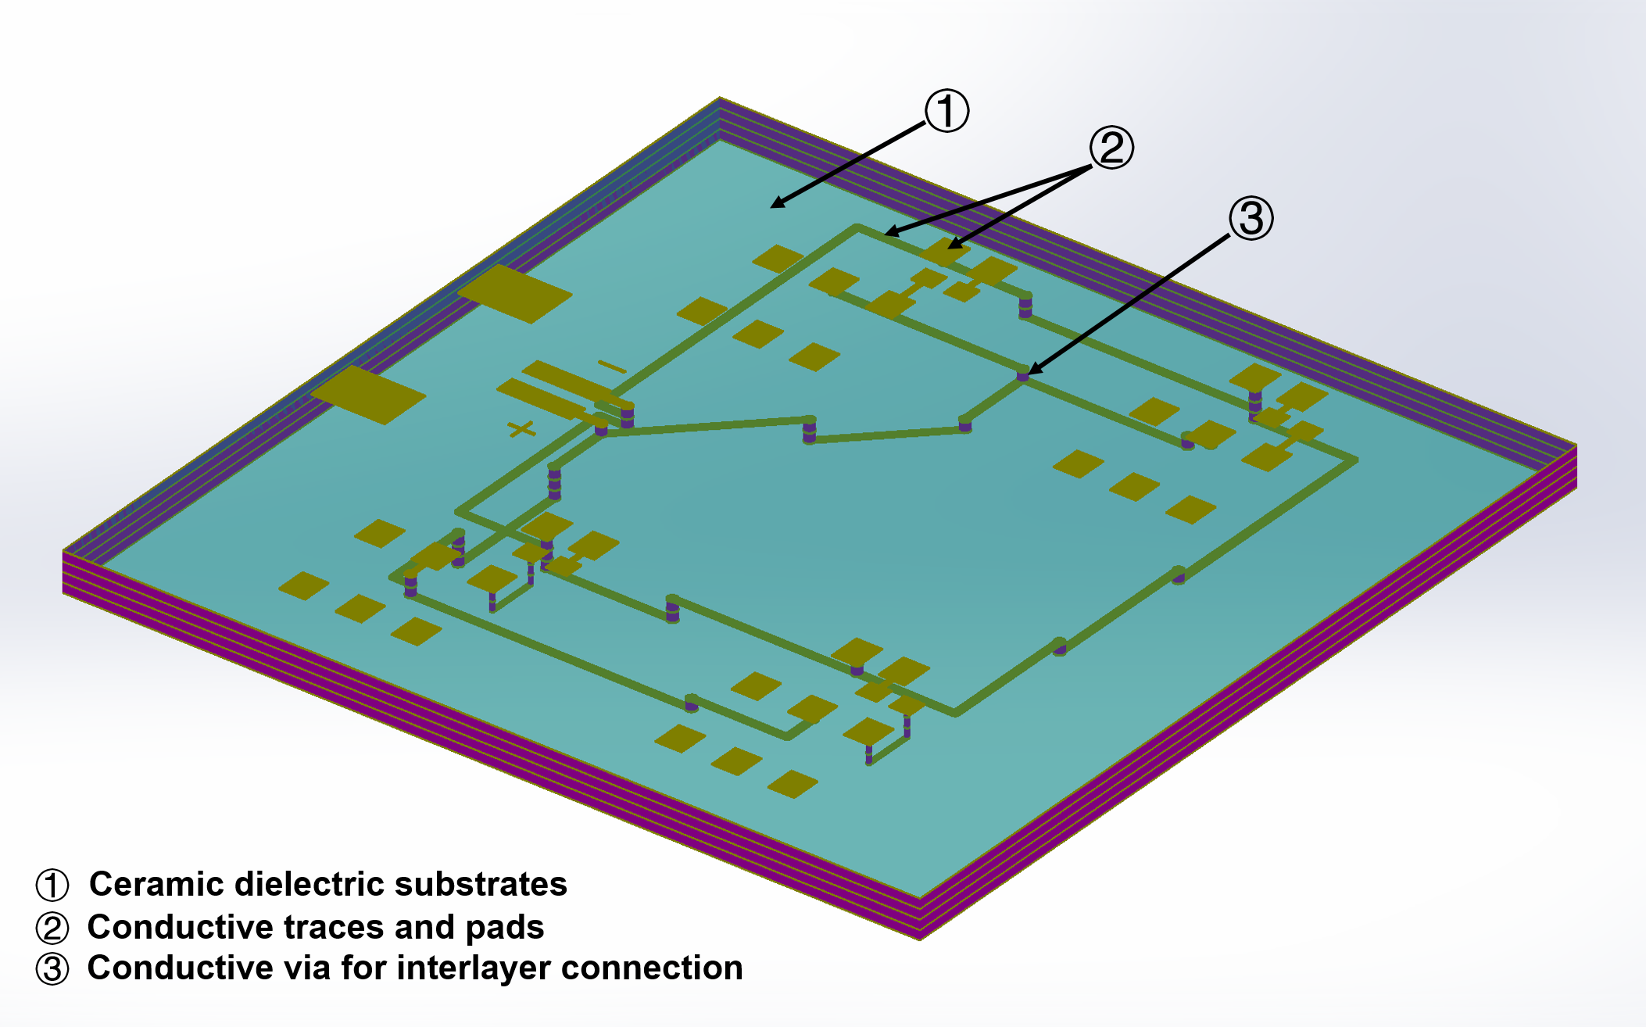
Direct fabrication by AM
Convectional tape-stacking way of fabricating LTCCs

Slide 5
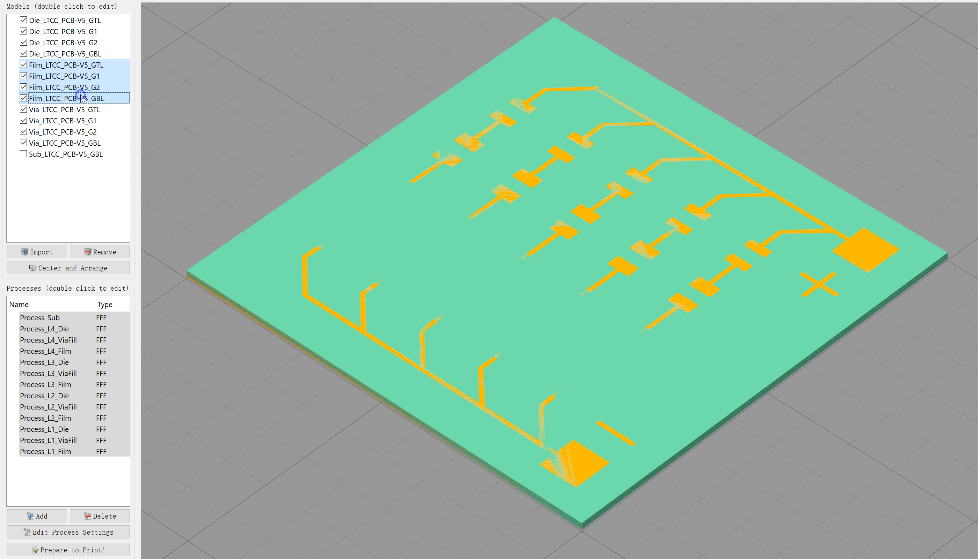
Direct fabrication of LTCC by AM
G-Code preview: Printing a LTCC circuit board for lightening 5 LEDs

Slide 6
Outline
Introduction LTCC LTCC and its application Conventional way of LTCC fabrication
Direct fabrication of LTCC Demonstration of LTCC direct fabrication Work flow of LTCC direct fabrication
Challenges and issues

Slide 7
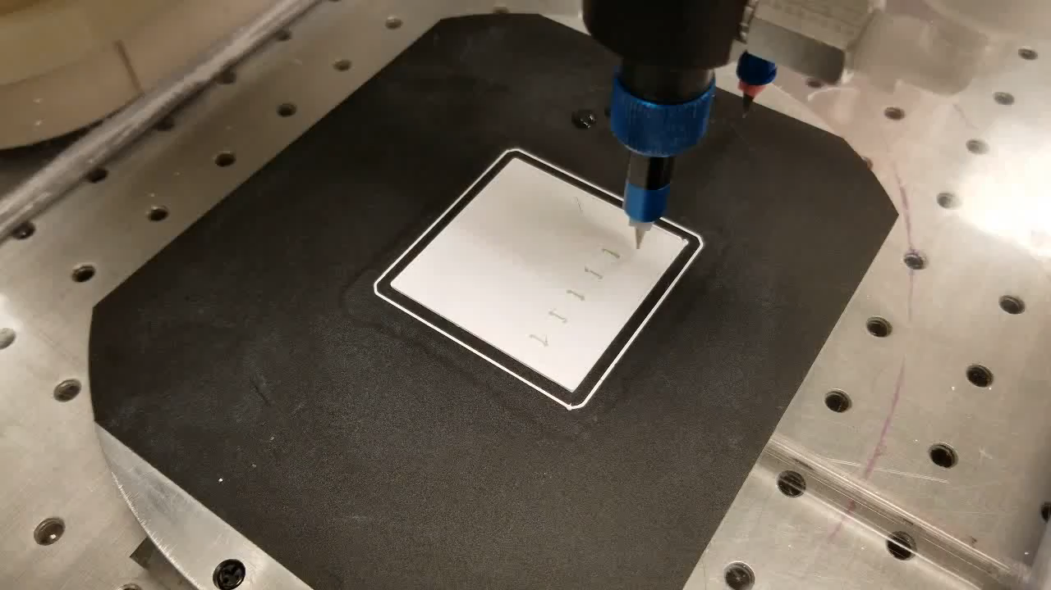
Demonstration of LTCC printing:
White material – ZrO₂ paste
Green material – Al₂O₃ paste with ~1wt% of Cr₂O₃

Slide 8
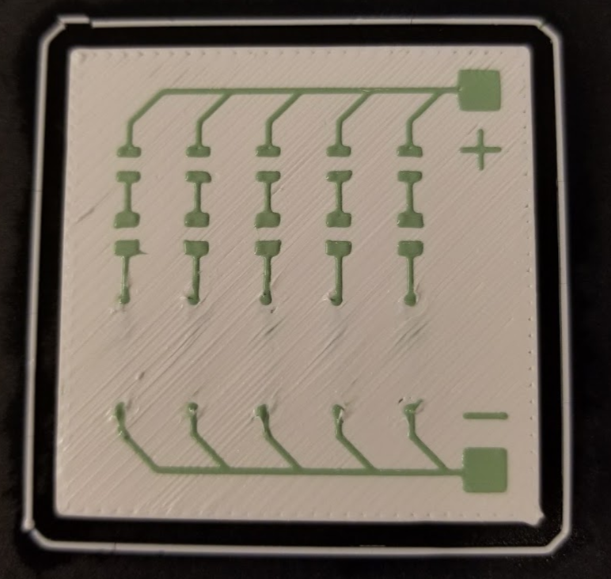
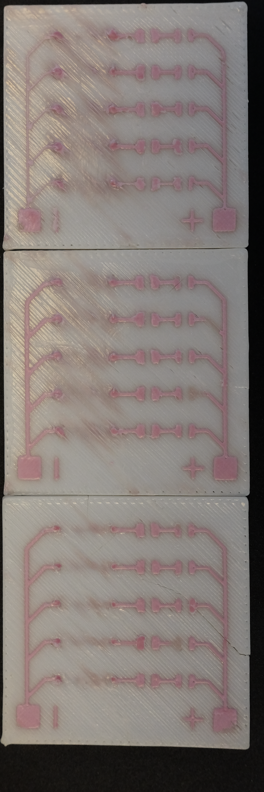
‘Green’ state
Sintered

Slide 9
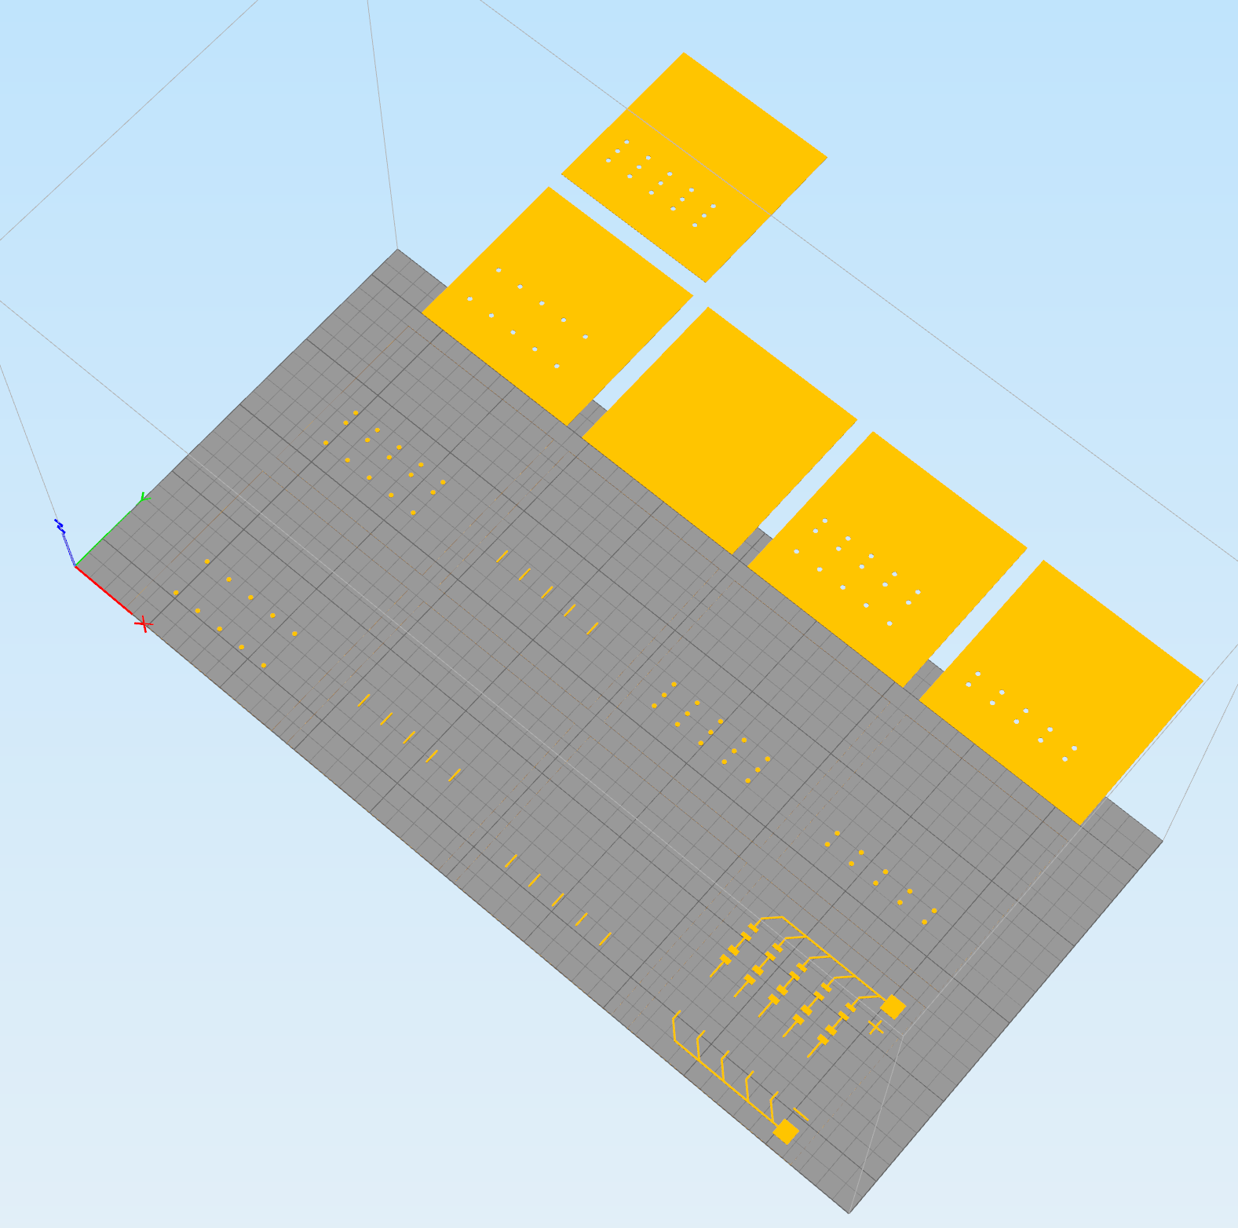
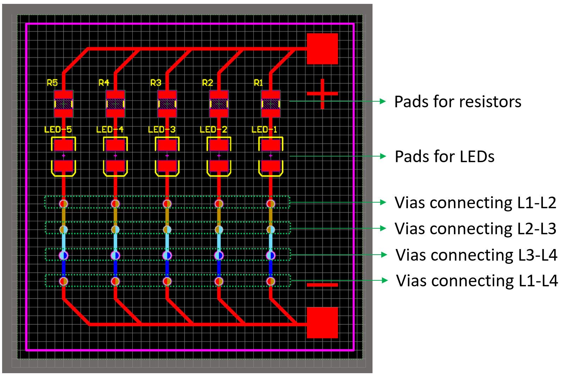
Work flow of LTCC direct fabrication
Step 1- Design PCB file in Altium Designer
Step 2- Convert PCB file into multiple STL files in ACE Translator

Slide 10
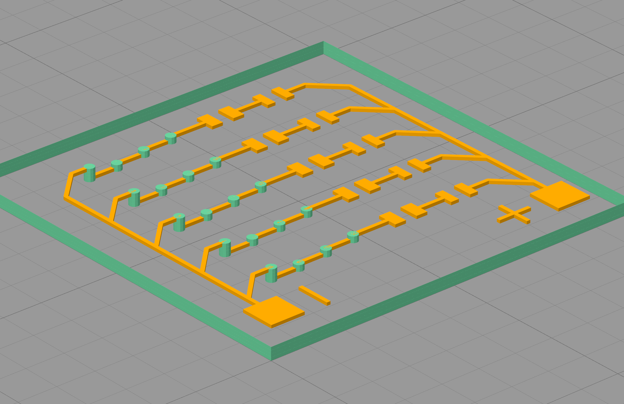
Step 3- Generate FDM-style G-Code in Simplify3D
Stacked STL models (dielectric layers excluded)

Slide 11
Tool-1: Base layer (ceramic)
Tool-2: Dielectric layers (ceramic)
Tool-3: Conductive film (traces, pads, metal)
Tool-4: Via-filling (metal)

Slide 12
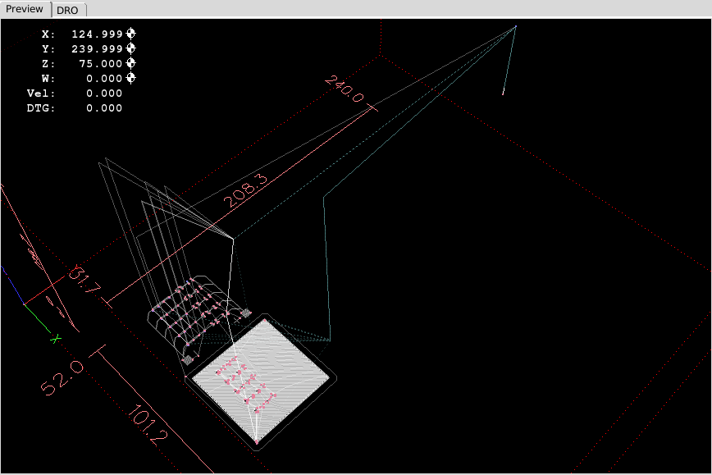
Step 4- Convert G-Code FDM-style to CODE-style using a converting program
Step 5- Print, dry and sinter

Slide 13
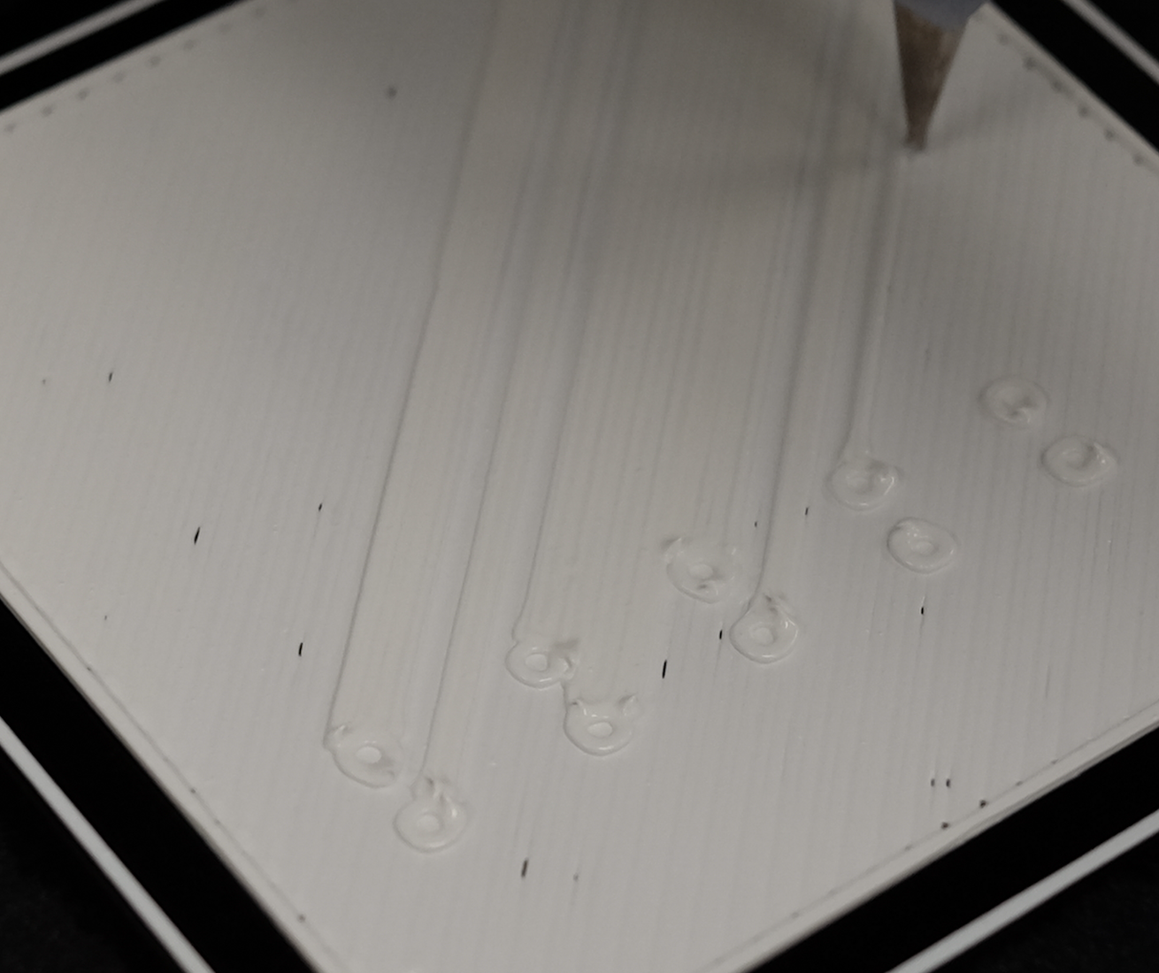
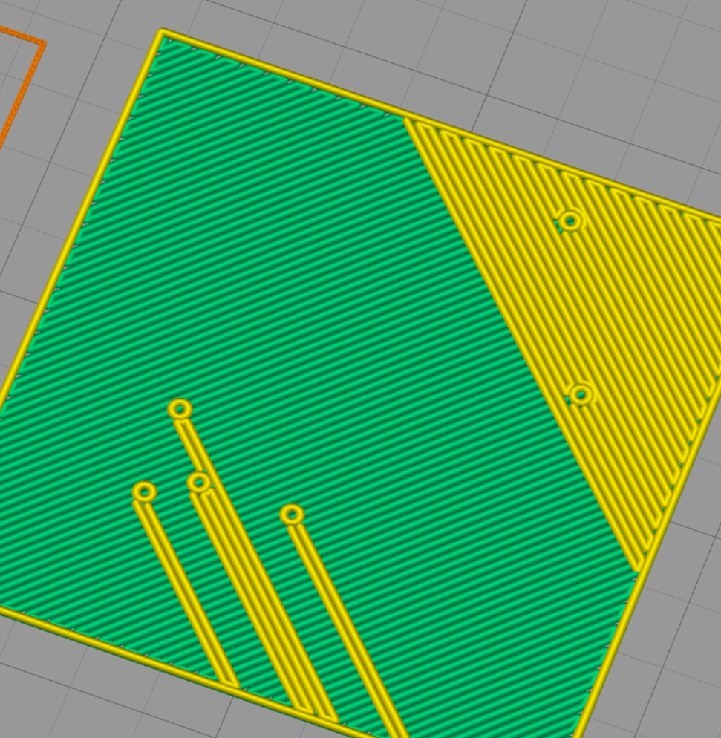
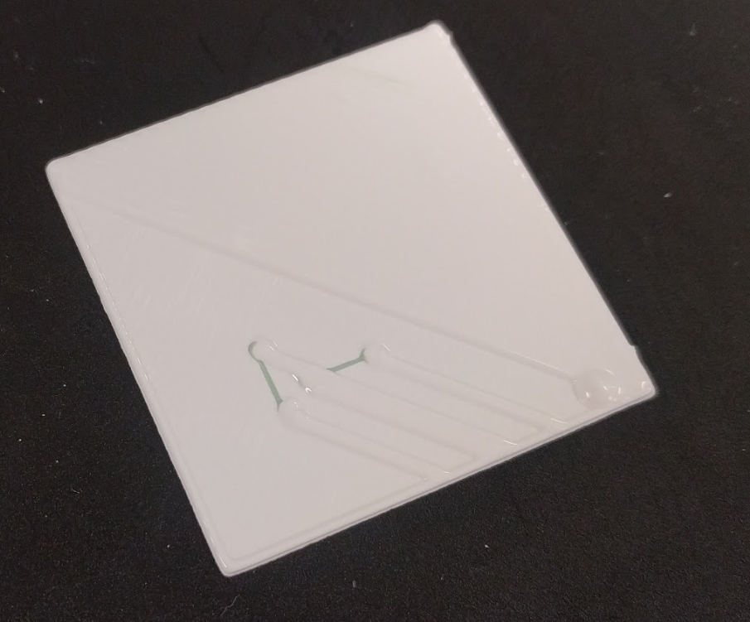
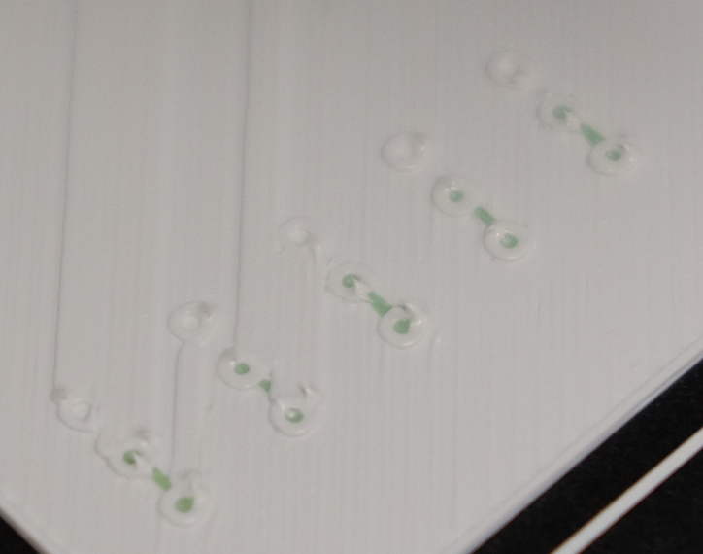
Challenges:
Limitations on dimensional resolution and accuracy
Thin paste spread out after being deposited,
making it difficult to form via holes
with small diameter.
The issue was mitigated by using
paste with higher viscosity
The pastes’ spreading behavior for straight lines and curvature line need to be investigated to
achieve precise control of the via hole size and trace width.

Slide 14
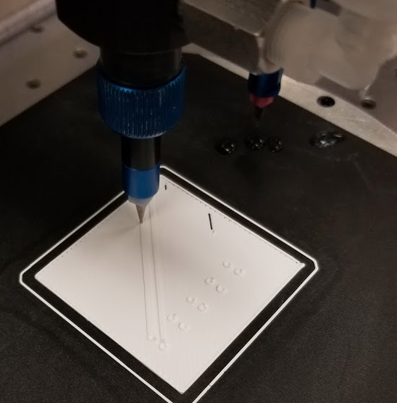
2. Nozzle clogging
Solution:
Further concern:
Extruder A finished one layer
Paste dried on the way
back to solvent bath,
Especially for organic
solvent-based paste.
Nozzle A&B moved into solvent
Extruder A retract and keep
some solvent in the nozzle tip
Extruder A become idle
Extruder B purged out solvent in the tip
One nozzle working,
the other one being idle
and easily get clogged on-the-fly
Extruder B become active
Finished one layer
Nozzle A&B moved into solvent
Extruder B retract and keep
some solvent in the nozzle tip

Slide 15
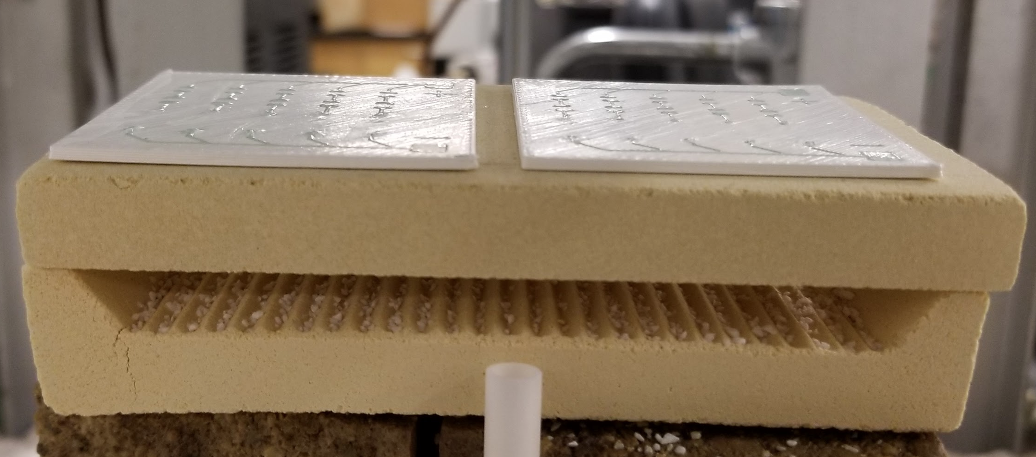
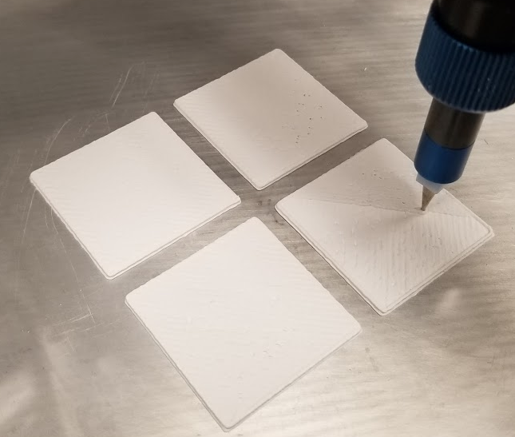
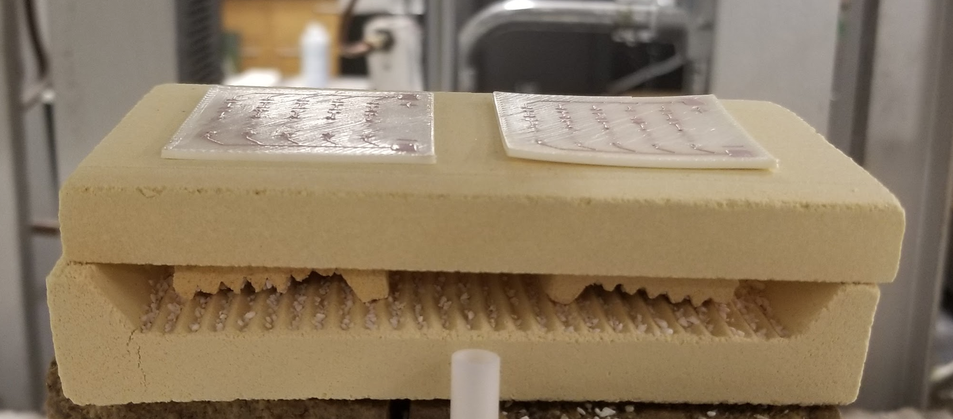
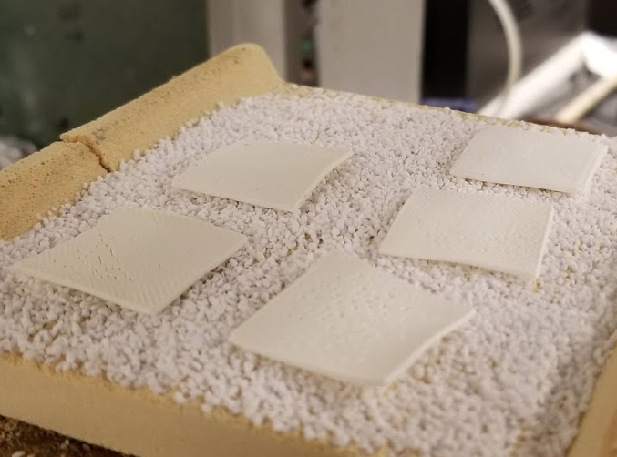
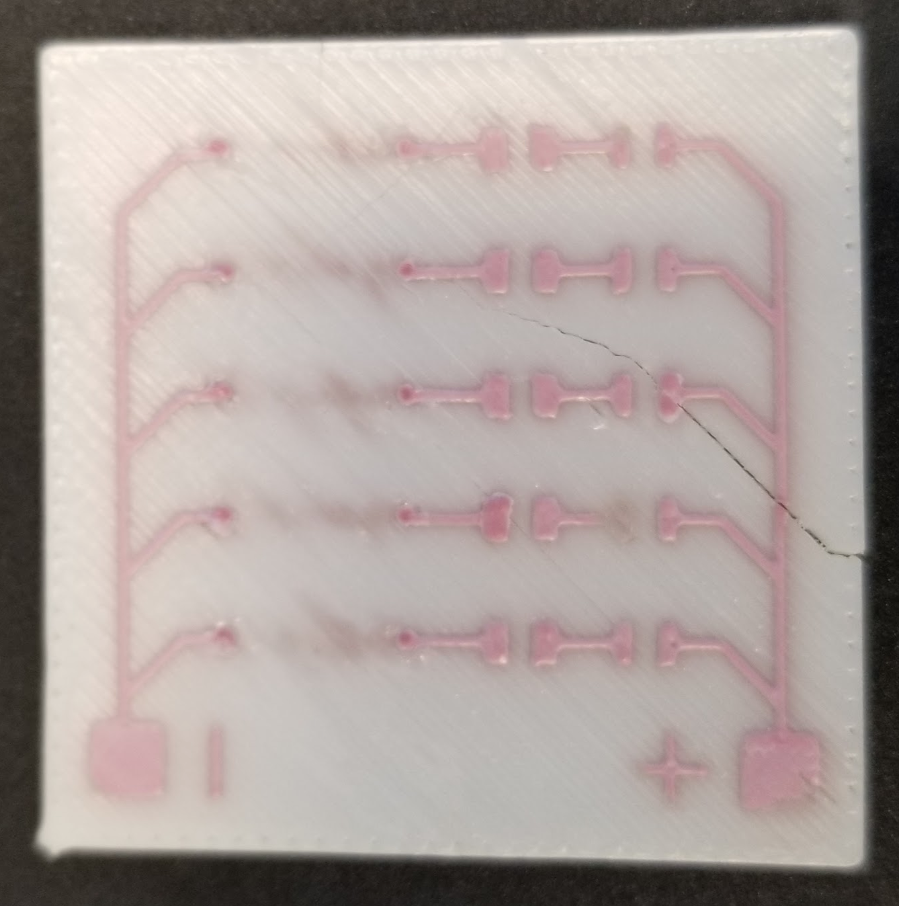
3. Part deformation
(ZrO₂ substrates, Al₂O₃ traces)
Dielectric substrates)
Before sintering
Before sintering
After sintering
After sintering

Slide 16
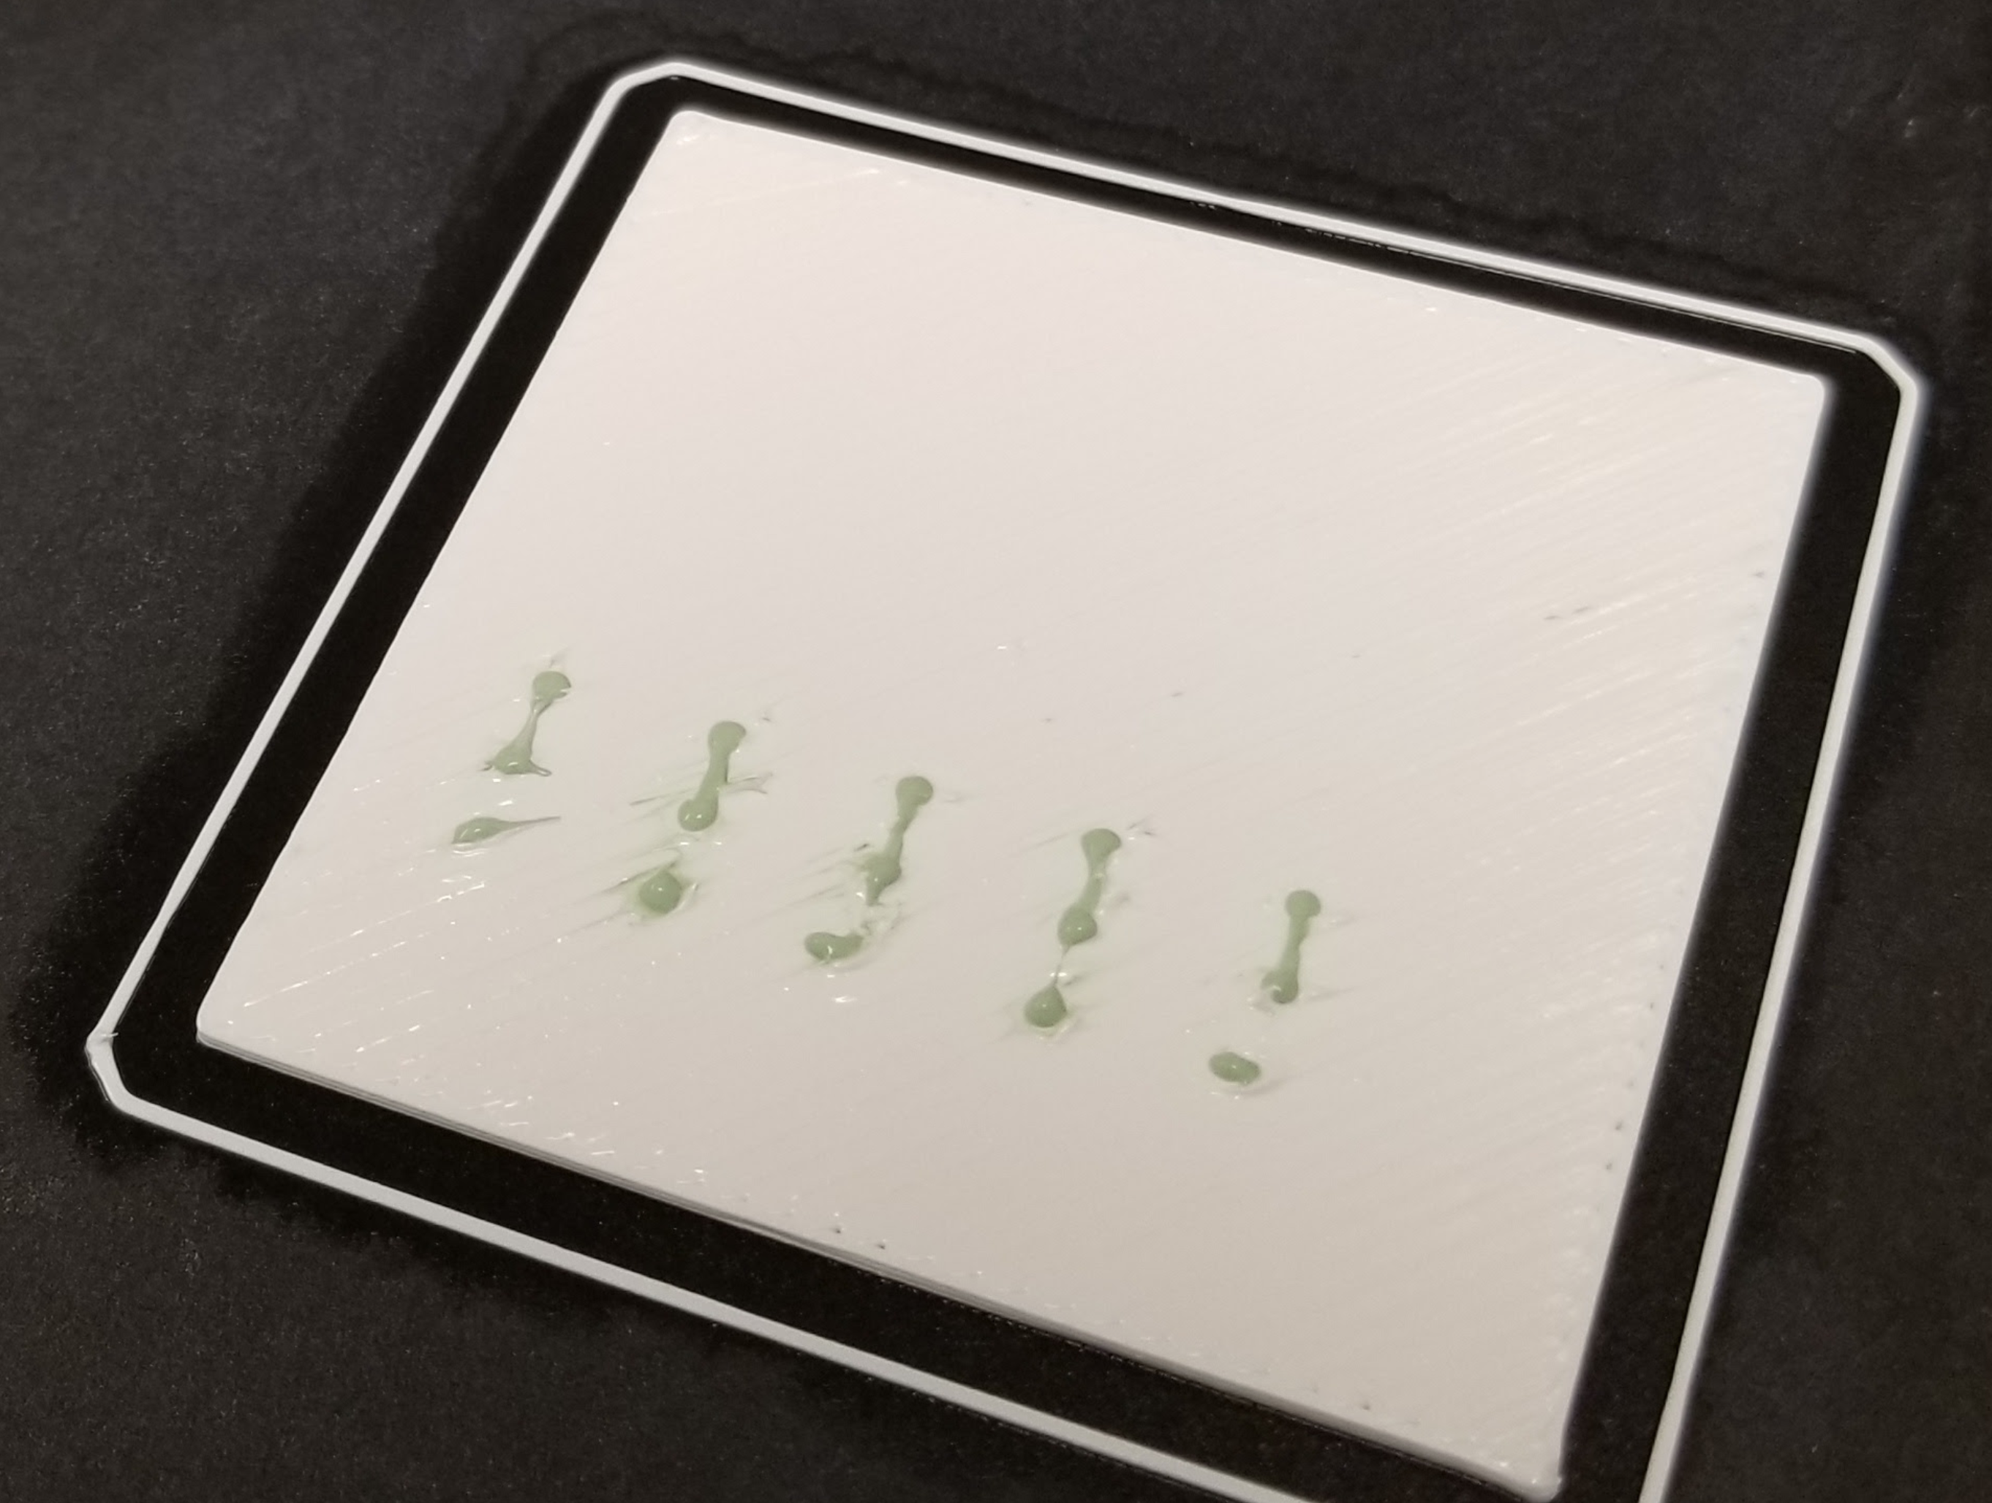
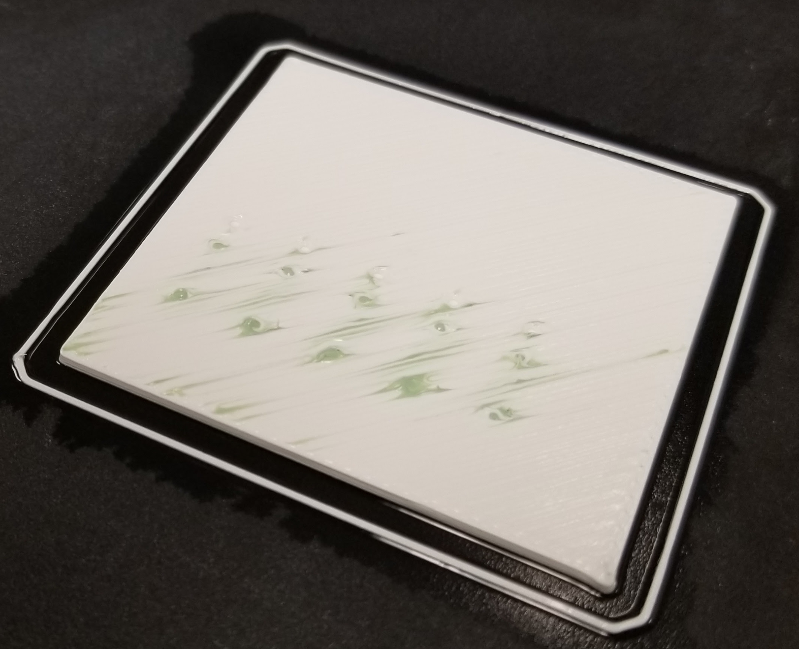
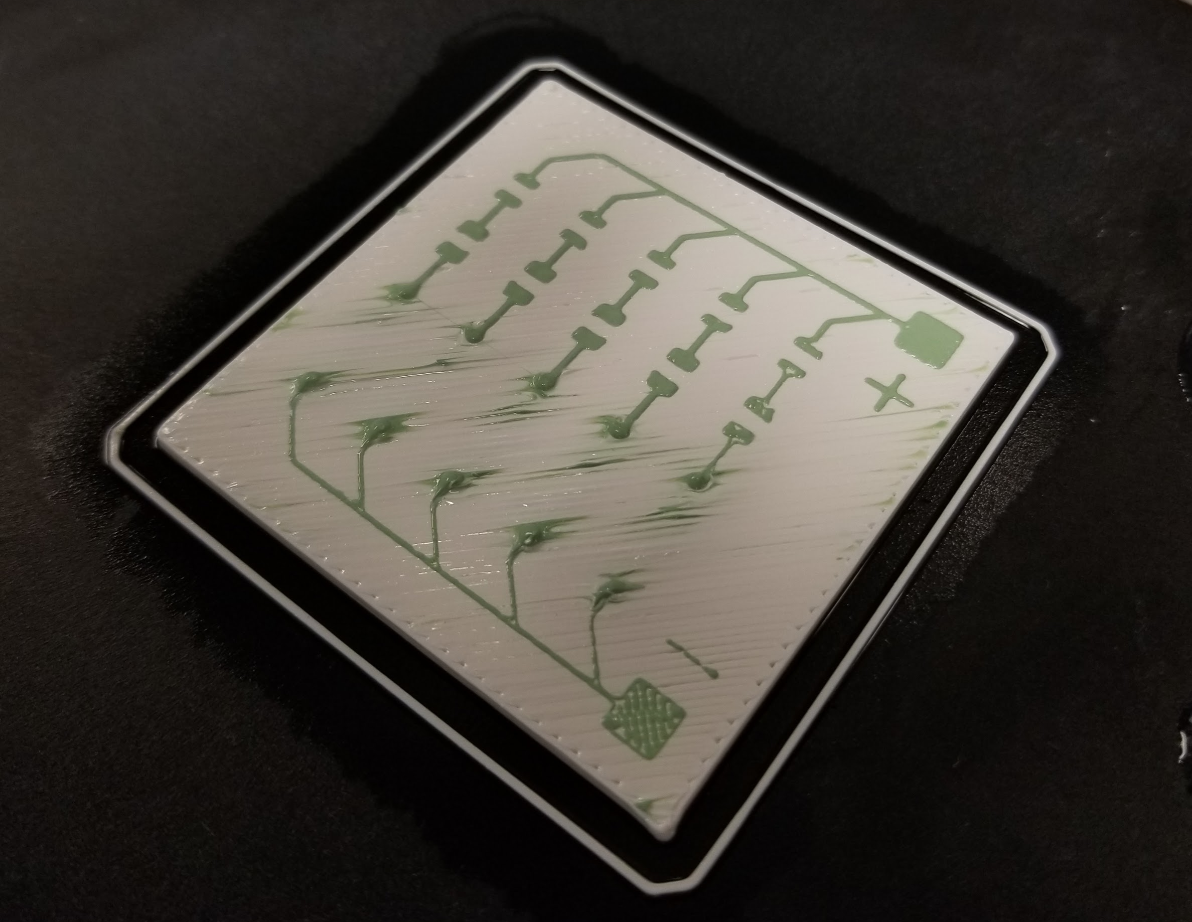
Issues observed when using Al₂O₃ and ZrO₂:
1. Undried conductive paste mixed with dielectric paste.
2. Dissimilar materials separate
during sintering.
Real LTCC pastes dries fast, and are
compatible for sintering。

Slide 17
THANK YOU!

